Slide 1
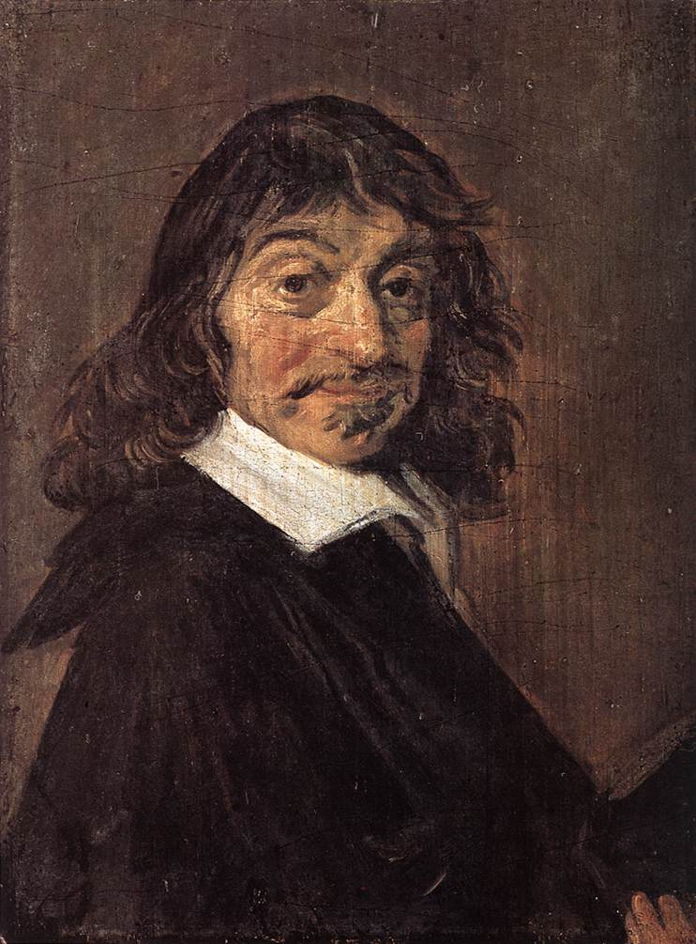
René Descartes (1596-1650)
Portrait by Frans Hals (1659)

Slide 2

Meditation One
The problem: (p. 13, 1st sentence)
The solution: (p. 13, 2nd sentence)
The method: (p. 13-4, second paragraph)

Slide 3
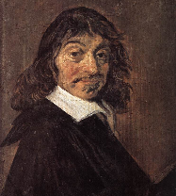
Meditation One: Doubting the Senses
An imagined dialogue (from p. 14, all three full paragraphs):
S: Sometimes the senses deceive, so we shouldn’t trust them. (“Surely whatever…”)
H: But they only deceive when far away, etc. (“But perhaps…”)
S: But insane people have hallucinations even about what’s up close. (“Unless perhaps…”)
H: But I’m not insane. (“But such people…”)
S: But my senses deceive me about what’s up close when I’m dreaming. (“This would be all well and good…”)
H: But it doesn’t feel like I’m dreaming right now. (“But right now…”)
S: Yes, but I’ve also thought the same thing when I was dreaming. (“As if I did not recall…”)
Dialogue form inspired by Jonathan Bennet edition
http://www.earlymoderntexts.com/authors/descartes

Slide 4
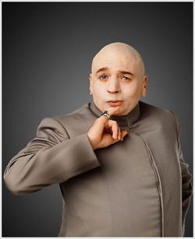

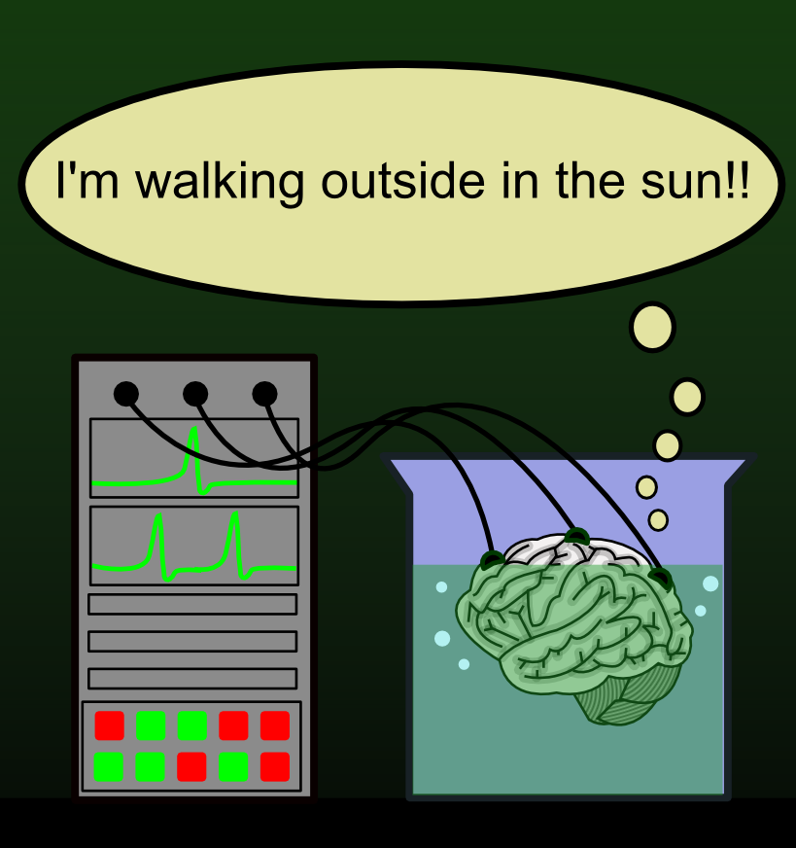
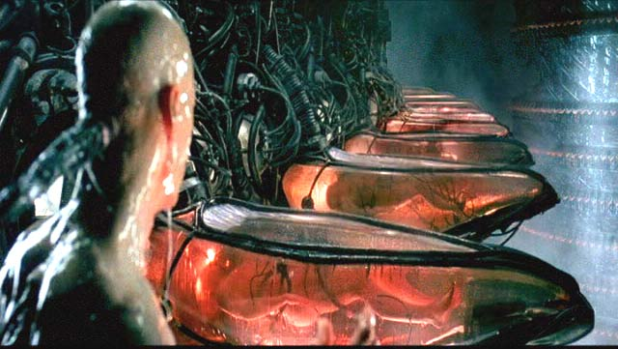
Meditation One: Doubting Everything
p. 14-15: Math is still certain even if I’m dreaming.
p. 15-17: But not if I’m being deceived by an all-powerful
evil genius.

Slide 5

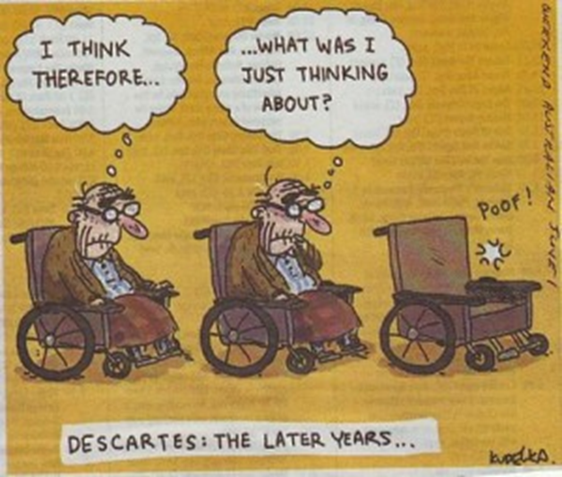
Meditation Two: “I exist”
Suppose I’m deceived in every possible way about all my beliefs: (p. 17-18)
1. Either I’m deceiving myself, or someone else is deceiving me.
2. If I’m deceiving myself, I exist.
3. If someone else is deceiving me, I exist.
-----
Therefore, 4. Either way, I exist.
But what am I? “a thinking thing” (p. 19)
What does that mean? (See p. 19-20)

Slide 6
Meditation Two: The Wax
Terminology: Imagination vs Understanding
Imagination = make-believe
The wax example (p. 21-23):

Slide 7
Meditation Two: The Wax
Terminology: Imagination vs Understanding
Imagination = make-believe
The wax example (p. 21-23):

Slide 8
Meditation Two: The Wax
Terminology: Imagination vs Understanding
Imagination = make-believe
Imag(e)ination = the faculty of forming images in your mind (from the Latin imaginari – “picture to oneself”)
The wax example (p. 21-23):
What changes about the wax? Notice that these are all features presented by the ‘imagination.’
What remains the same? What faculty of the mind recognizes this sameness?
What conclusion does Descartes draw from this?

Slide 9
Meditation Three
Terminology: Objective reality and Formal Reality (p. 28; cf p. 9 and p. 5)
Objective reality = content of an idea
Formal reality = the form the idea exists in (i.e. thoughts in your head)
Background Assumption: Principle of Sufficient Reason (p. 28)
PSR: Nothing can come from nothing, and more cannot come from less.
Method: Look for the causes of ideas (p. 29-30)

Slide 10
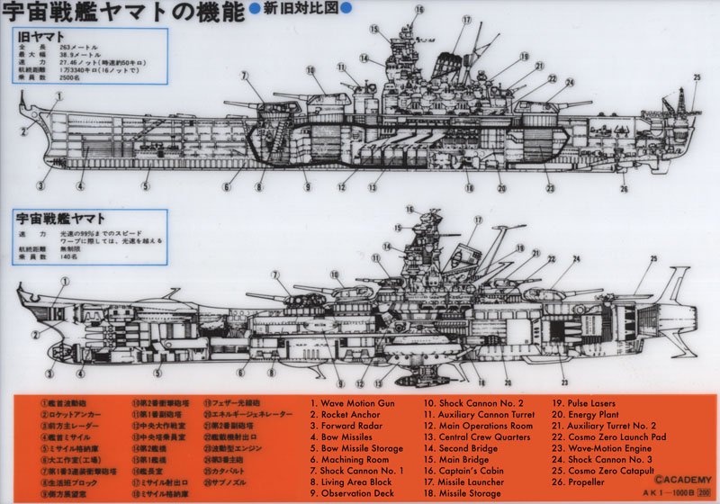
Space Battleship Yamoto from Star Blazers (1974)
Explained verbally in
lecture: Example of
fictional idea with lots of
“objective” reality, that
needed a powerful cause
(e.g. Matsumoto’s knowledge
and imagination)
Drawing by Leiji Matsumoto
http://ourstarblazers.com/vault/202/

Slide 11
Dr. Bowman’s Trash-to-Gold Machine
Explained verbally in lecture:
Example of fictional idea with very little “objective” reality
It doesn’t take a very powerful mind to come up with this.
Trash Input Conveyor
Transmutation Machinery
Gold Output Conveyor

