Slide 1
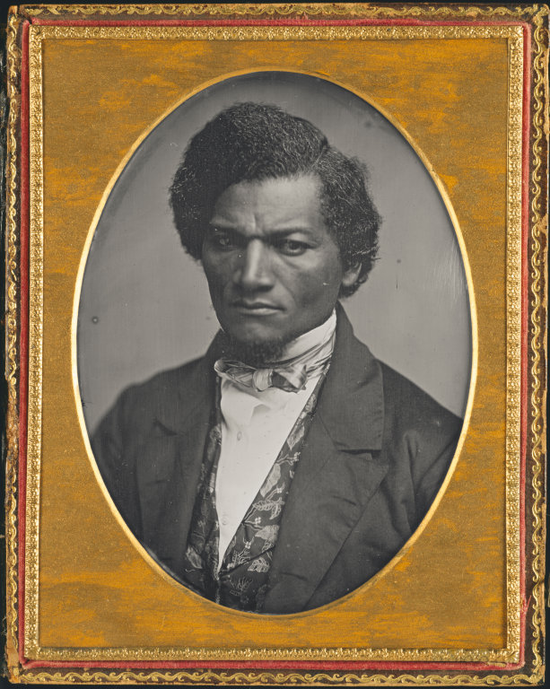
Frederick Douglass
Daguerreotype Photo by Samuel J. Miller, taken between 1847 and 1852
Location: Art Institute of Chicago
http://www.artic.edu/aic/collections/artwork/145681

Slide 2
Timeline
1776: Declaration of Independence
1793: Decree of General Liberty ends slavery in St. Domingue (Haiti)
1807/1808: Atlantic slave trade banned in Britain / the U.S.
1810-1824: The events from the novel Georges take place
1833: Slavery abolished in the British Empire
1848: Communist Manifesto by Marx and Engels
1850-1869: The events from the novel L'Assommoir take place
1852: Frederick Douglass, “What to the Slave is the 4th of July?"
1863: Emancipation Proclamation (1863)
1865: Adoption of 13th Amendment to U.S. Constitution
1888: Pope Leo XIII, In Plurimis ; abolition of slavery in Brazil
1891: Pope Leo XIII, Rerum Novarum

Slide 3
“What to the American slave is the 4th of July?”
Frederick Douglass: Who is he? Why is his identity as the speaker important? (e.g. p. 189; 194-5)
The nature of American slavery: (e.g. p. 195; 196; 197-8) What made the Fugitive Slave Law especially egregious? (p. 199)
Political principles and hypocrisy: (e.g. p. 196-7; 199; 202-203)
Religious principles and hypocrisy: (e.g. p. 200-202; 202-203)
The value and limits of philosophical argument: (p. 195-6)
The value and limits of appeals to history: (p. 189-193; esp. 193)
Douglass in relation to Marx and to the themes of L’Assommoir (also cf Chapter XI of Narrative of the Life of Frederick Douglass)

Slide 4
Douglass’s Anti-Slavery Argument (p. 195-6)
1. The slave is a man (“a moral, intellectual , and responsible being”).
(How does Douglass prove that even slaveholders believe this? What other reasons does he give to show that it’s ridiculous to be asked to prove this)
2. Man is entitled to liberty.
(How does Douglass show that his audience is committed to this belief?)
Therefore, 3. The slave is entitled to liberty.
(How does Douglass respond to the claim that slavery is ordained by God?)

