Slide 1
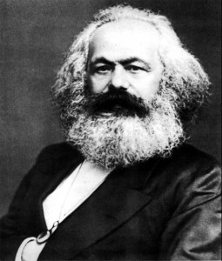
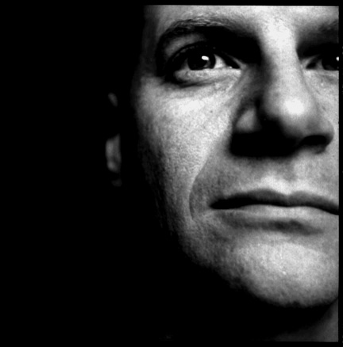
Karl Marx (1818-1883)
Johnathan Wolff
(1959-present)

Slide 2
Marx on Religion
Class and Class Struggle
Communism

Slide 3
Three Views of Human Reason and Social Progress
Enlightenment Liberalism: See, e.g. Wollstonecraft, p. 98-99, 100; Paine (in Wollstonecraft), p. 94); Declaration of Independence; Declaration of the Rights of Man
Conservatism: See e.g. Edmund Burke; Klemens von Metternich): See, e.g. Metternich (in Lualdi), p. 139, 140; Burke (in Wollstonecraft), p. 84, 85
Historical Materialism: Karl Marx; see definition in Wolff, p. 52

Slide 4
Class and Class Struggle
Bourgeoisie
Proletariat
Petite Bourgeoisie
Land Owners/Aristocrats
The origins of inequality (Wolff, p. 49)

Slide 5
Marx on Religion
Marx and the ‘Young Hegelians’
Marx compared to Paine
Religion as “the opium of the people” (3 features; Wolff p. 20)
Religion as symptom (see Wolff, p. 13)

Slide 6
Communism
Capitalism and Alienation (Wolff, p. 94)
Freedom and domination (e.g., see Lualdi, p. 152)
Revolutionary dictatorship (Wolff, p. 92)
‘Utopian’ vs ‘scientific’ communism (Wolff, p. 93)

Slide 7
Marx on Religion
Class and Class Struggle
Communism
Bourgeoisie
Proletariat
Petite Bourgeoisie
Land Owners/Aristocrats
The origins of inequality (Wolff, p. 49)
Marx and the ‘Young Hegelians’
Marx compared to Paine
Religion as “the opium of the people” (3 features; Wolff p. 20)
Religion as symptom (see Wolff, p. 13)
Capitalism and Alienation (Wolff, p. 94)
Freedom and domination (e.g., see Lualdi, p. 152)
Revolutionary dictatorship (Wolff, p. 92)
‘Utopian’ vs ‘scientific’ communism (Wolff, p. 93)

Slide 8
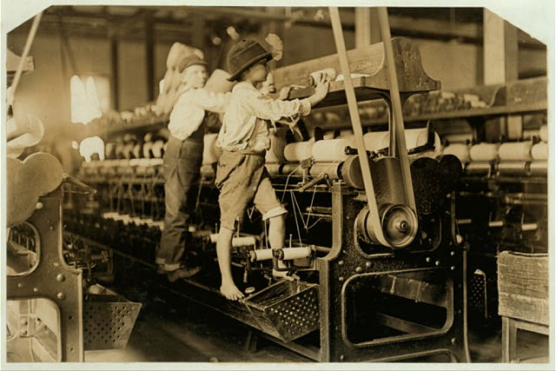
488 Macon, Ga. Lewis W. Hine 1-19-1909. Bibb Mill No. 1 Many youngsters here. Some boys were so small they had to climb up on the spinning frame to mend the broken threads and put back the empty bobbins. Location: Macon, Georgia.
(Lewis Hine, National Child Labor Committee, http://www.loc.gov/pictures/collection/nclc/)

Slide 9
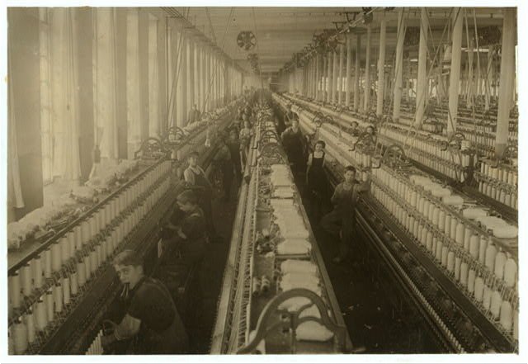
General view of the spinning room, Cornell Mill, showing some of the young boys and girls employed there. See names on other photo. Cornell Mill. Location: Fall River, Massachusetts.
(Lewis Hine, National Child Labor Committee, http://www.loc.gov/pictures/collection/nclc/)

Slide 10
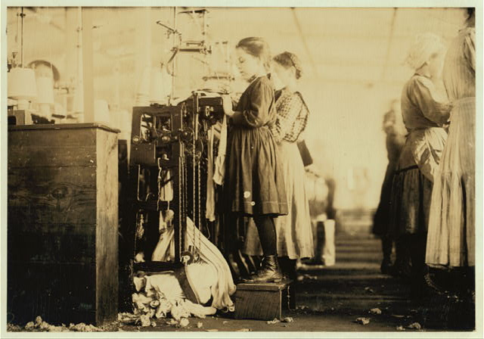
This little girl (like many others in this state) is so small she has to stand on a box to reach her machine. She is regularly employed as a knitter in London [i.e., Loudon?] Hosiery Mills. Said she did not know how long she has worked there. (See report and other photos.) Location: Loudon, Tennessee.
(Lewis Hine, National Child Labor Committee, http://www.loc.gov/pictures/collection/nclc/)

