Slide 1
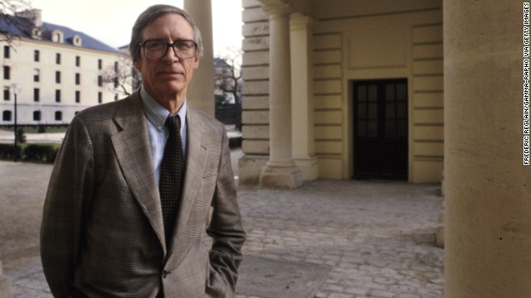
John Rawls (1921-2002)
(Paris, 1987)

Slide 2
Timeline
1939-1945: World War II
  1939: Rawls enrolls at Princeton; Germany invades Poland; France & Britain declare war
  1940: The Battle of France; Marc Bloch writes Strange Defeat
  1941: Japanese attack Pearl Harbor; U.S. enters the war; Vercors writes Silence of the Sea
  1942: U.S. forces withdraw from the Philippines; Vercors publishes Silence of the Sea
  1943: Rawls graduates Princeton, enlists in the U.S. Army as an infantryman.
  1945: German surrender; Battle of Luzon; Hiroshima and Nagasaki; Japan surrenders; end of the war; Allied occupation of Japan; Sartre delivers “Existentialism is a Humanism”
Post-1945: After the War
  1946: Rawls leaves the army and returns to Princeton as a graduate student
  1971: Rawls publishes A Theory of Justice
  1993: Rawls publishes The Law of Peoples
  1997: Rawls writes “On my Religion”
  2001: Rawls publishes Justice as Fairness: A Restatement

Slide 3
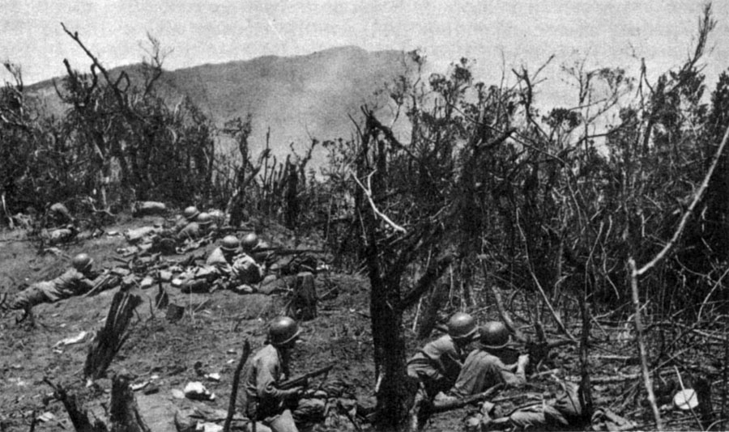
128th Infantry Regiment, 32nd Infantry Division
Villa Verde Trail, Luzon, PI (April 1, 1945)

Slide 4
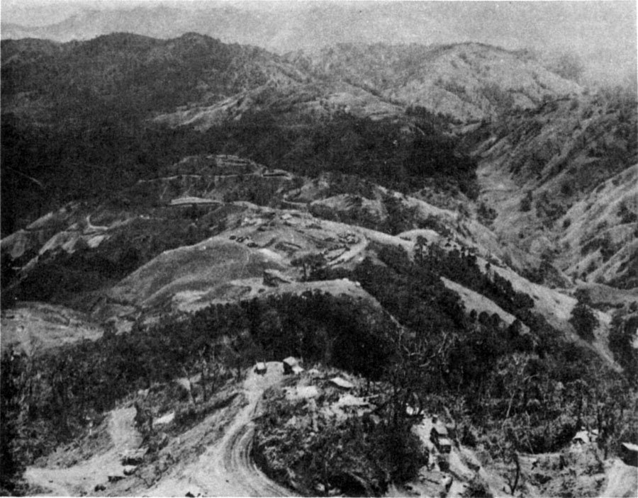
Villa Verde Trail, Luzon, PI

Slide 5
Rawls on finding a major
“I never thought of the law, the chosen career of my father and my brother, as I felt that my stammering would prevent that; and besides it never appealed to me any more than business did. In succession I tried various subjects. Chemistry, which I began with, soon proved beyond me, as did mathematics, even more so. I experimented with painting and art. I took a course in music and was told gently by my greatly talented teachers, Roger Sessions and Milton Babbitt, whose talent was really wasted on me, that I should do something else instead. This advice would have gained A.W. Tucker’s approval, had he cared; for he muttered, when I told him I had given up the idea of studying mathematics, “I hope you find something you can do Rawls,” as if he couldn’t imagine what it might be. Nor at that time could I, but I kept trying and eventually ended up in Philosophy.”
(As quoted in Rawls by Samuel Freeman, p. 2)

Slide 6
Rawls on never quite getting it right
“Yet, as I have said, I have never felt satisfied with the understanding I could gain of Kant’s overall conception. This leaves a certain unhappiness, and I am reminded of a story about John Marin… Marin’s paintings … are a kind of figurative expressionism. In the late forties he was highly regarded as perhaps our leading artist, or among the few. … For eight year in the 1920s Marin went to Stonington, Maine, to paint and Ruth Fine, who wrote a splendid book on Marin, tells of going there to see if she could find anyone who had known him then. She finally found a lobsterman who said, ‘Eeah, eeah, we all knew him. He went out painting in his little boat day after day, week after week, summer after summer. And you know, poor fellah, he tried so hard, but he never did get it right.’ That always said it exactly for me, after all this time ‘Never did get it right.'”
From Lectures on the History of Political Philosophy (p. xv-xvi)

Slide 7
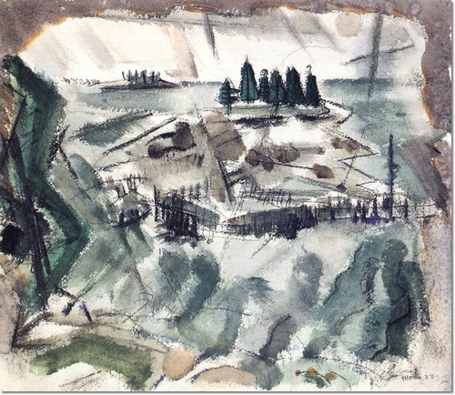
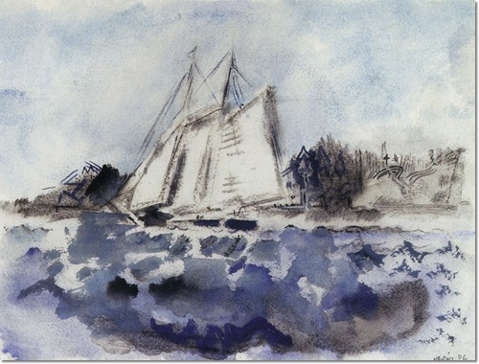
John Marin, Deer Isle, Islets, Maine (1922)
John Marin, Boat Off Deer Isle Maine (1926)

Slide 8
“Justice as Fairness”
The aims: To specify principles for adjudicating disagreements about how to balance freedom and equality in a democratic society, and to specify a point of view which shows why we should adopt those principles.
The two principles:
  Equal Basic Liberties Principle
  Fair Equality of Opportunity + the “Difference Principle”
The point of view: the “Original Position”
  First, imagine that the rules of society are chosen as part of a ‘social contract’ that all citizens agree to.
  Second, imagine that you had to pick these rules from behind a “veil of ignorance” which makes you temporarily forget personal details about your religious affiliation, your particular skills, your race, your wealth, etc.
  Rawls claims that (a) whatever rules you would agree to under these hypothetical conditions are the rules of justice; and (b) that under these conditions you would choose his two principles.

Slide 9
“Justice as Fairness”
The two principles:
  Equal Basic Liberties Principle:
  “Each person has the same indefeasible claim to a fully adequate scheme of equal basic liberties, which scheme is compatible with the same scheme of liberties for all.” (Justice as Fairness: A Restatement, p. 42)
  Fair Equality of Opportunity + the “Difference Principle”:
  “Social and economic inequalities are to satisfy two conditions: first, they are to be attached to offices and positions open to all under conditions of fair equality of opportunity; and second, they are to be to the greatest benefit of the least-advantaged members of society (the difference principle).” (Justice as Fairness: A Restatement, p. 42-3)

Slide 10
Reading Guide for 12/11
Section 6.1: What question “immediately” arises from the idea of society as a fair system of cooperation? What kind of answer does “justice as fairness” adopt, and why?
Section 6.2: What is the “serious difficulty” faced by any account of justice based on the idea of a contract? How is the “veil of ignorance” meant to address that difficulty?
Section 6.3: Pay special attention to the first paragraph, which summarizes the results of Sections 6.1 and 6.2. How is the ‘original position’ connected to earlier ‘social contract’ theories? What are the two main features that distinguish Rawls’s theory from earlier social contract theories?
Sections 6.4 and 6.5: What objection does Rawls consider, and how does he reply? What is the original position supposed to model?
Section 7.1: What are the two moral powers?
Section 7.2 What does it mean to say that the conception of persons as free and equal is “political”? Where does such a political conception come from?

